Slide 1


Shri Vishnu Engineering College For Women(A), Bhimavaram Recognized by AICTE, Permanent Affiliated to JNTU-Kakinada, Accredited by NACC with A+ Grade . Department of Computer Science & Engineering ( Accredited by NBA in TIER-I Category )
UPI Fraud Detection Using MACHINE LEARNING
Project Review - 4
MASTER OF TECHNOLOGY IN COMPUTER SCIENCE AND ENGINEERING
By
Ester Rani Chadalavada (22B01D5802)
UNDER THE GUIDENCE OF
Dr. V. Purushothama Raju, Ph. D.

Slide 2
Contents
Abstract
Introduction
Literature Survey
Existing System
Disadvantages in Existing System
Proposed System
Algorithms to be Implemented
Modules & Implementation Architecture
Requirements
Advantages
Conclusion
References

Slide 3
Abstract
People can use UPIs for online transactions as it provides an efficient and easy-to-use facility.
With the increase in usage of UPIs, the capacity of UPI misuse has also enhanced.
UPI frauds cause significant financial losses for both UPI holders and financial companies.
In this Project, the main aim is to detect such frauds, including the accessibility of public data, high-class imbalance data, the changes in fraud nature, and high rates of false alarm.

Slide 4
Introduction
UPI payment system is nothing but a virtual card system
card-based purchases can be categorized into two types:
1) Physical card
2) Virtual card.
In a Physical-card based purchase, the cardholder presents his card physically to a merchant for making a payment.
To carry out fraudulent transactions in this kind of purchase, an attacker has to steal the card.
If the cardholder does not realize the loss of card, it can lead to a substantial financial loss to the cardholder.
In the second kind of purchase i.e., Virtual Card , only some important information about a card (card number, expiration date, secure code) is required to make the payment. Such purchases are normally done on the Internet or over the telephone, In that case there is a chance to make fraud transactions and fraudsters can steal cardholder data, so Fraud detection algorithms is very useful for preventing frauds and to save cardholder data.

Slide 5
Literature Survey
TITLE | AUTHOR | MONTH/ YEAR | JOURNAL/ CONFERENCE | EXPLANATION
Random Forest for Credit Card Fraud Detection | Hettiarachchi H.A.C.K. | December 2022 | IEEE | SVM (Support Vector Machine) Small change in data will not affect the model stability. Long training time, lots of memory required.
Credit Card Fraud Detection - Machine Learning methods | Nikhil Jadhav | March 2022 | IEEE | Logistic Regression It talks about coefficient size with direction (positive/negative) If (No. of observation< features) than it may lead to over fit.
A Comparative Study of Machine Learning Techniques for Credit Card Fraud Detection Based on Time Variance | Felix G. Hamza-LuP | April 2021 | IEEE | Gaussian Naïve Bayes The prediction and training process is fast and gives best result with small data sets.
Credit Card Fraud Detection: A Novel Approach Using Aggregation Strategy and Feedback Mechanism | Mengwei Pang | October 2020 | IEEE | K-Neighbor Classification Since it doesn’t require training time new data can easily added to it. Need scaled data. It can’t work with high dimensionality.
A Survey of Credit Card Fraud Detection Techniques: Data and Technique Oriented Perspective. | Heinrich F., Joeres F., Lawonn K. | March 2021 | IEEE Trans | Random Forest It uses bagging and ensemble learning as a result it reduces over fitting and improves the accuracy of a model. It is complex in nature.

Slide 6

Problem Definition
There are lots of issues that make this procedure tough to implement and one of the biggest problems associated with fraud detection is the lack of real-world data to perform experiments on.
The reason behind this is the sensitive financial data associated with the fraud that has to be kept confidential for the purpose of customer’s privacy.
There should be a proper means to handle the improper data. Noise is the errors that is present in the data, for example, incorrect dates.
This noise in actual data limits the accuracy of generalization that can be achieved, irrespective of how extensive the training set is.

Slide 7
Existing System
To detect transactions, three machine-learning algorithms were implemented.
There are many measures used to evaluate the performance of classifiers or predictors, such as the Gradient Boost Classifier, Vector Machine, Random Forest, and Decision Tree.
It uses random forest algorithm to identify the fake account. It is efficient when it has the correct inputs and when it has all the inputs. When some of the inputs are missing it becomes difficult for the algorithm to produce the output.
It able to detect risk based on your historical data. It can suggest or implement rules to reduce the fraud risk automatically.

Slide 8
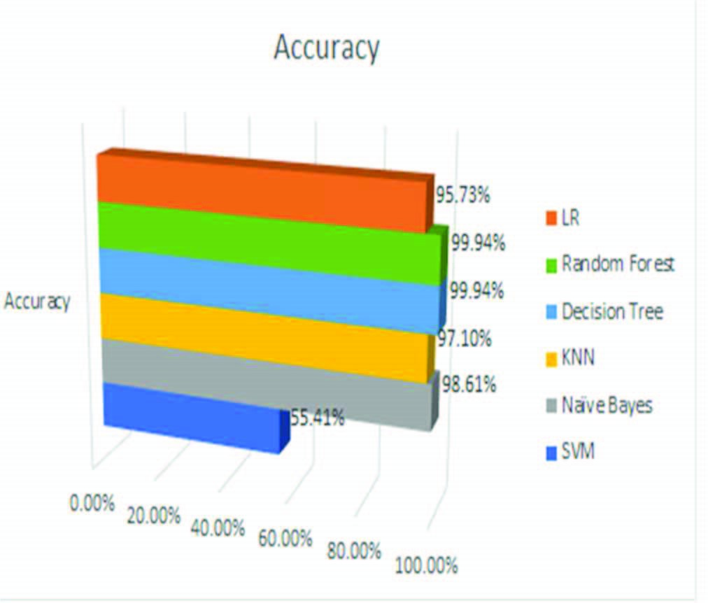
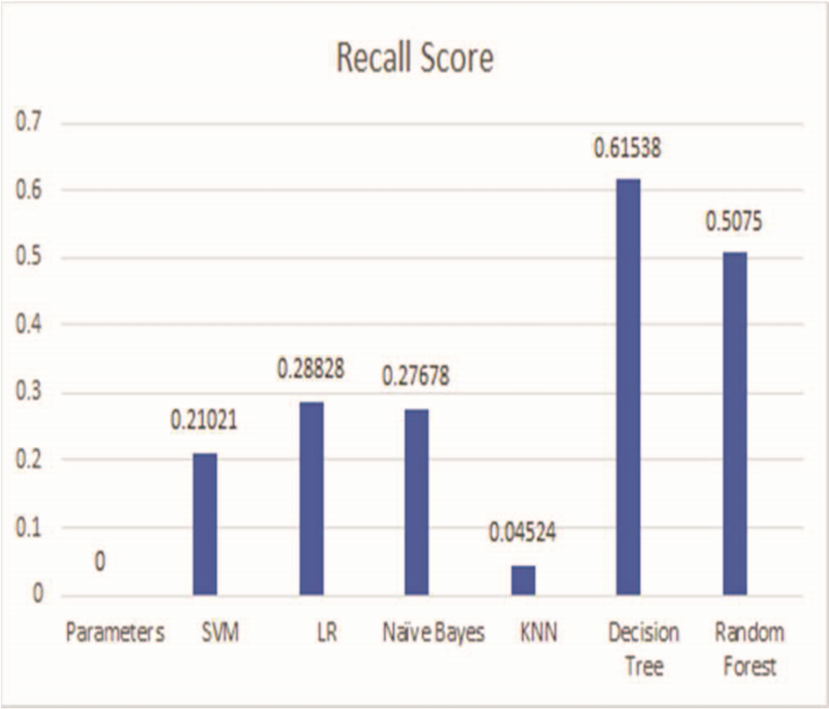
Existing Algorithms
Fig : Accuracy % for existed algorithms
To detect fraud related transactions, three machine-learning algorithms were presented and implemented. There are many measures used to evaluate the performance of classifiers or predictors, such as ,
The Gradient Boost Classifier, KNN, LR
Support Vector Machine, Naïve Bays
Random Forest, and Decision Tree
The main drawback of these algorithms - accuracy is very less compared to proposed algorithm.

Slide 9
Disadvantages In Existing System
Expensive
Lack of Human Intelligence
Loss Control
Difficult To Interpret
Inaccurate Prediction

Slide 10
Proposed System
Using modern technique like artificial neural network.
Different machine learning algorithms will be compared , including Auto Encoder, Local Outlier Factor, K-means Clustering.
Using above algorithms to find out optimal solution for the problem and implicitly generating the result of the fraudulent transaction.
The main aim is to detect the fraudulent transaction and to develop a method of generating test data.
The proposed efficient fraud detection system can be used by all UPI issuing companies and their clients to minimize their losses.

Slide 11
Algorithms to be implemented
Artificial neural network algorithm will be implement
Different machine learning algorithms are also implemented such as
Auto Encoder
Local Outlier Factor
K-means Clustering.
Very efficient To prevent the fraudulent transactions and to decrease the financial loses.

Slide 12
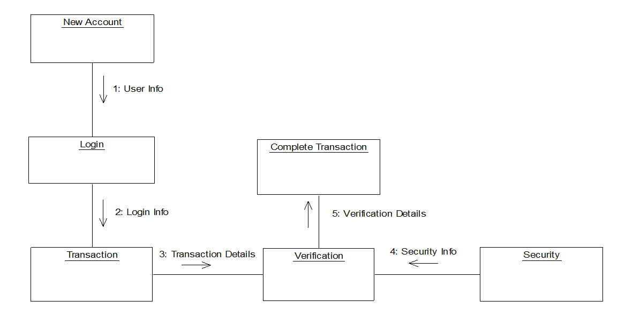
Implementation Architecture Diagram

Slide 13
Modules
New UPI
Given Input- Request from the user for the card.
Expected Output-Assigning an account to requested user.
Login
Given Input- Give username and password of particular user.
Expected Output- Login to user’s account.
Security information
Given Input- Give the security information by answering security questions.
Expected Output- Updation of account with the security details.
Transaction
Given Input- Give the account details and performs transaction.
Expected Output- Updation of database.
Verification
Given Input- Checks with user’s stored details like security answers or hidden details. Expected Output-If the verification is success, user can perform transaction, else blocks the cards

Slide 14
Requirements
Hardware
Processor : intel i3
Software
Operating system : Windows
Coding Language : Python
HARD DISK : 500 GB
RAM : 2 GB
Front End : IDE Anaconda
Backend : MySQL

Slide 15
Advantages
High Security from unauthorized use of UPI
Avoids fraud usage of card through online transactions.
Detect if card used by others if card lost.
Anomalies detection is faster & more accurate.
Better Predictions & Cost-effective detection
Saves Time and Money

Slide 16
Conclusion
UPI fraud becomes a serious concern to the world.
Fraud brings huge financial losses to the world. This urged UPI companies have been invested money to create and develop techniques to reveal and reduce fraud.

Slide 17
Reference
K. Sim, V. Gopalkrishnan, A. Zimek, and G. Cong -‘‘A survey on enhanced subspace clustering,’’ Data Mining Knowledge Discovery, vol. 26, no. 2, pp. 332–397, 2019.
S. Mcskimming -‘‘Trade-based money laundering: Responding to an emerging threat,’’ Deakin Law Rev, vol. 15, no. 1, 2020.
Nitu Kumari, S. Kannan and A. Muthukumaravel - “UPI Fraud Detection Using Genetic-A Survey” published by MiddleEast Journal of Scientific Research , IDOSI Publications, 2014
Satvik Vats, Surya Kant Dubey, Naveen Kumar Pandey - “A Tool for Effective Detection of Fraud in UPI System”, published in International Journal of Communication Network Security ISSN: 2231 – 1882, Volume-2
S.H. Projects and W. Lovo , ― JMU Scholarly Commons Detecting UPI fraud : An analysis of fraud detection techniques,‖ 2020.

Slide 18


